Slide 1
Solar Energy Generator: Design Rendering Description
Prototype system will be mounted in a pelican case with battery and other peripherals.
Laser Cut Delrin Panel will cover all electronics and have display, buttons and a rotary encoder mounted to it.
All front panel electronics will connect to the main PCB via a wiring harness with 0.1” header pin connectors. Future iterations will use JST connectors.
Souriau UTS circular connectors allow sealed external connections to loads and sources.

Slide 2
Solar Energy Generator:
Front Panel Diagram
Pelican Case
Delrin Front Panel
OLED Display
Select
Display
Rotary Encoder
Load
Back
Enter
Momentary Push Buttons

Slide 3
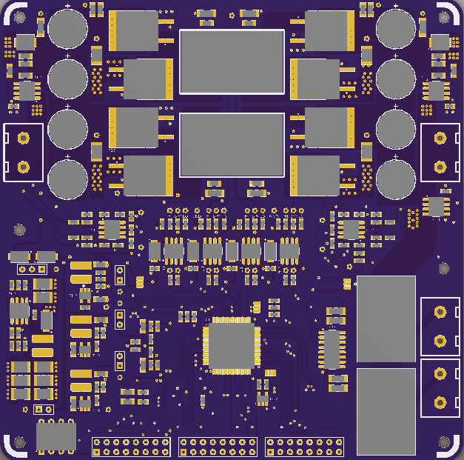
Solar Energy Generator:
Internal case layout
LiFePO4 Battery
Pelican Case
5V Buck Module
Port A
Port C
PCB
Port B
Port D
I2C/SPI Isolator

Slide 4
Port Connections
Souriau UTS 8 Pin connectors
Ports A and B: Solar Panel Input, Battery Voltage output
Ports C and D: Regulated 5V output, Battery Voltage output
All connectors share the same body, but different pin locations are populated depending on function. Connection something to the wrong port wont cause any damage.
Each port Contains locations for Panel+, Panel-, Battery V+, Regulated V+, GND, Control, and pins for future expansion with sensors and digital communication.

Slide 5
Solar Energy Generator:
Final PCB Overview
Power Stage
Panel Input
Battery Terminal
Voltage + Current Sense
Gate Drive
Voltage + Current Sense
Battery Temp, I2C
12V, 5V, 3.3V, 1.8V Regulators
MCU
Load switch relays
Load Output 2
SPI, SCI, GPIO
De bounce
Load Output 1
Programming
Buttons
Display

Slide 6
Solar Energy Generator:
A Usage Scenario
Solar Panel
Battery
Serial Interface
Microcontroller, Light sensor, Wireless radio
LED Lamp

Slide 7
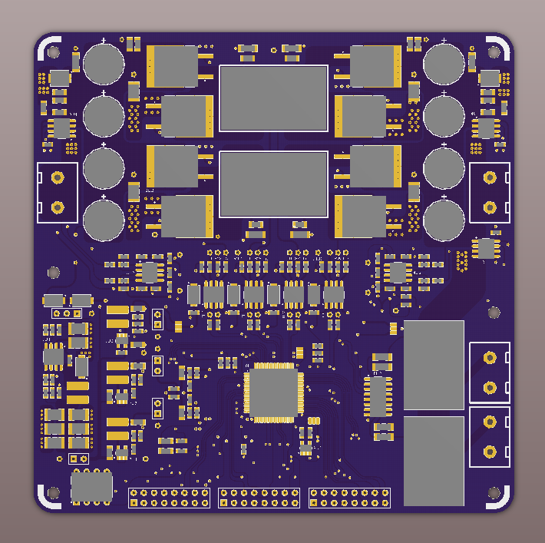
Solar Energy Generator:
Final PCB 3D View

